Slide 1
CTF model for long reverberation Date：2022. 05. 10
Telecom Electroacoustics Audio(TEA) Lab
Presenter:
Anchi Yuan
Notes:
Hello everyone
I’m today’s presenter siang. I’m going to share some of my present work in source separation problem. My topic is comparative studies of source separation using semi-blind and blind source separation approaches.

Slide 2
Outline
Determine NWIN NFFT hopsize
Simulation settings
ATF estimation
Source predictions
Future work

Slide 3
Determine NWIN NFFT hopsize (1)
Ref
Blind speech dereverberation with multi-channel linear prediction based on short time fourier transform representation
Tomohiro Nakatani;Takuya Yoshioka;Keisuke Kinoshita;Masato Miyoshi;Biing-Hwang Juang
2008 IEEE International Conference on Acoustics, Speech and Signal Processing

Slide 4
Determine NWIN NFFT hopsize (2)
Original one
ATF
Source signal
hopsize
NWIN
Reference
ATF
Source signal

Slide 5
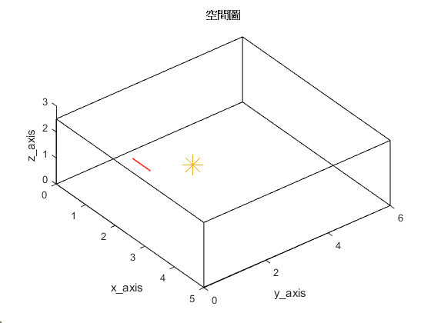

Simulation settings
Uniform linear array (ULA)
Number of microphones = 30
Spacing = 0.02m (2cm)
Aperture = (30-1)*0.02 = 0.58 m
Room size = 5m $×$6m $×$2.5m
Sampling frequency = 16kHz
Reverberation time T₆₀ = 0.2s
First microphone location [1, 1.5, 1]
2.5m
origin
Source location [2, 2.6, 1]
5m
6m

Slide 6



Determine NWIN NFFT hopsize (3)
T₆₀ = 0.2s microphone received signal | Time domain convolution | ATF pts | NWIN_H | NFFT_H | hopsize_H | ATF pts | NWIN_H | NFFT_H | hopsize_H
 |  |  | 64 | 64 | 32 |  | 64 | 2048 | 64
 |  | Source pts | NWIN | NFFT | hopsize | Source pts | NWIN | NFFT | hopsize
 |  |  | 64 | 64 | 32 |  | 2048 | 2048 | 64
origin
Ref
In our cases, N stands for NFFT_H, NFFT and NWIN, M stands for hopsize_H and hopsize

Slide 7
ATF estimation (1)
Ground-truth RIR (T₆₀ = 0.2s)

Slide 8
ATF estimation (2)
origin
rms = 0.4819
Ref
rms = 0.2444
ATF pts | NWIN_H | NFFT_H | hopsize_H
 | 64 | 64 | 32
Source pts | NWIN | NFFT | hopsize
 | 64 | 64 | 32
ATF pts | NWIN_H | NFFT_H | hopsize_H
 | 64 | 2048 | 64
Source pts | NWIN | NFFT | hopsize
 | 2048 | 2048 | 64
R_{ss} R_{sy} initialize with ground-truth source T₆₀ = 0.2s

Slide 9

Source predictions
Ground-truth source
Predicted source with parameters below |  |  |  | Predicted source with parameters below
ATF pts | NWIN_H | NFFT_H | hopsize_H | ATF pts | NWIN_H | NFFT_H | hopsize_H
 | 64 | 64 | 32 |  | 64 | 2048 | 64
Source pts | NWIN | NFFT | hopsize | Source pts | NWIN | NFFT | hopsize
 | 64 | 64 | 32 |  | 2048 | 2048 | 64
origin
Ref
R_{ss} R_{sy} initialize with ground-truth source T₆₀ = 0.2s

Slide 10
Future work
Find solution
Blind system ID → Benesty’s approaches

Slide 11


